Slide 1
DDLC – RKT
27th Aug ‘20

Slide 2
Overview on Drug Discovery and Development
Drug Development Life Cycle is the process of discovering, testing, and getting approval for new drugs
This whole process takes about 10 – 15 years to create a new drug while costing the company around $2.6 billion
For every 5,000 – 10,000 compounds that are discovered and worked upon, ultimately only one receives approval

Slide 3
Drug Development Life Cycle
Need in Society
Drug discovery and Development
Clinical Trails
Regulatory Approval
Manufacturing and Packaging
Distribution and Logistics

Slide 4
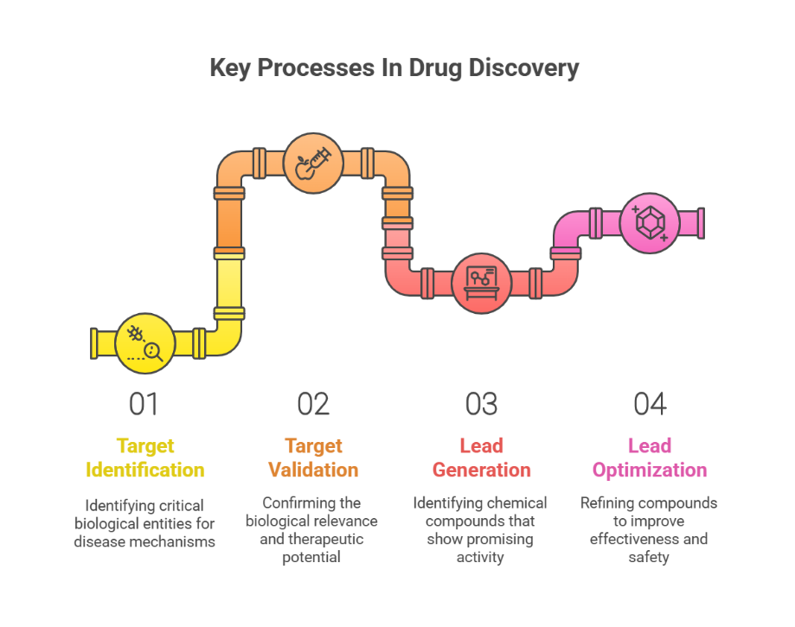
1. Drug Discovery and Development
1. Understand the disease | Pathology
Pathology refers to the study of diseases, including their causes, progression, and effects on the body. It plays a crucial role in drug development and healthcare by helping researchers and healthcare professionals understand how diseases develop
2.Target Identification
In this step researchers find the molecule that plays a key role in the disease and which can be druggable
Few techniques to mention–
A. Genome-Wide Association Studies (GWAS)-Compares genetic differences between healthy and diseased subject
B. Mass Spectrometry (MS): Measures protein abundance and modifications in disease vs. normal cells
C. AI-Based Approaches - Uses AI and machine learning to predict new drug targets from vast datasets
Notes:
Understanding the disease, it helps to know which cells are affected, for example in Alzheimer diseased patients, we can find beta amyloid plaque and tau protein tangle so these protein will disrupts the neural function which will cause memory loss
So finding the right druggable target whether it can be a protein or gene GWAS- compares genetic diff between diseased and healthy individuals example: type 2 diabetes TCF7L2 A gene MASS SPECTROMY: IN LUNG CANCER PRESENCE OF EGFR(EPIDERMAL GROWTH FACTOR RECEPTOR) IN MUTATED TUMORS AI BASED : During covid 19 the drug baricitinib used for jak(janus kinase inhibitor) potential drug which can be repurposed

Slide 5
Drug Discovery and Development
3. Target Validation
After choosing a target for a disease, scientists need to confirm its role in the disease and check if it can be treated with a drug.
Key Techniques:
Gene Knockout (KO) Models – Scientists remove (knock out) a specific gene to see if it affects the disease. If the disease gets better or disappears, this gene is likely important.
RNA Interference (RNAi) – Uses small molecules like siRNA or shRNA to turn off specific genes and study their effects on the disease.
4. Lead Compound
A lead compound is a promising molecule that shows early signs of working against a disease. Scientists improve its properties to develop it into a real medicine.
Notes:
Gene Knockout: PCSK9 in cholesterol regulation, mice with pcsk9 gene is removed and showed low cholesterol level, this validated that pcsk9 is target for treating hypercholesterolemia, so now they developed the drug which are totally inhibit PCSK9
RNA interference: they will silence the rna here and check for the genes role for examplel

Slide 6
Drug Discovery and Development
Techniques to Find Lead Compounds:
Natural Products – Many useful drug molecules come from nature, such as plants, fungi, and microorganisms.
De Novo Design – Scientists create new drug molecules from scratch using computer models or chemistry based on the disease target.
High-Throughput Screening (HTS) – Researchers quickly test thousands or millions of compounds to find promising ones.
Biotechnology – Uses living organisms, like bacteria or cells, to produce medicines by modifying their genes.
Early Safety Testing:
Pharmacokinetics (PK) – Studies how the body absorbs, distributes, metabolizes, and eliminates the drug (ADME).
Pharmacodynamics (PD) – Examines how the drug affects the body, including its mechanism of action and therapeutic effects.
Notes:
Natural Products: Penicillin from plant penicillin notatum
De Novo Design: HIV protease inhibitors
HTS: Bortezomib a proteasome inhibitor for multiple myeloma
Biotechnology: Insulin produced using genetically modified e coli bacteria

Slide 7
Drug Discovery and Development
5. Lead Optimization
Lead optimization is the process of improving a lead compound to make it safer, more effective, and ready for clinical trials.
Key Steps:
Creating Analogues – Scientists make small changes to the compound’s structure to see if it works better. Each new version is tested again for Pharmacokinetics (PK) and Pharmacodynamics (PD).
Virtual Screening & Computational Models – Computer simulations help predict how changes might improve the drug.
Toxicity Consideration – Ensuring the drug is safe and does not cause harmful effects.
Candidate Drugs – The best-performing compounds are selected for further development.
Once a promising drug is found, patents are filed to protect its discovery.
Notes:
Terfanadine for toxicity consideration

Slide 8
Patents
A patent is a legal right granted by the government, which gives them the right to make, use, sell, or distribute an invention for a certain period. And in this period no other companies can manufacture or sell these drugs
The typical patent life is 20 years from the date of filing
Patents are filed to Patent and Trademark Office
Patents can be for the composition of the drug, formulation of the drug, process, method of use
Exclusivity
Exclusivity is the period when a drug is protected from competition in the market, even if the patent has expired.
There are many types of exclusivity -

Slide 9
Exclusivity
Types of Drug Exclusivity
Orphan Drug Exclusivity – Drugs for rare diseases (fewer than 200,000 patients) get 7 years of market exclusivity under the Orphan Drug Act.
Pediatric Exclusivity – If a company conducts studies proving a drug’s safety and effectiveness in children, they get an extra 6 months of exclusivity.
Biologics Exclusivity – Biologic drugs receive 12 years of protection from biosimilar competition in the U.S. after approval.
Generic Exclusivity (180-Day Rule) – The first manufacturer to file for a generic version of a brand-name drug gets 180 days of exclusive sales rights.
Hatch-Waxman Act – Allows drug companies to extend patent life by up to 5 years if FDA approval caused delays in launching the drug.

Slide 10
2.Pre-Clinical Trials
Preclinical trials are the lab and animal studies done before human clinical trials begins
Some types of clinical trials are:
In Vivo - Experiments done on whole, living organisms like mice, rats
Ex Vivo - Experiments done on organs, tissues, or cells removed from a living body, but tested outside the body in a controlled environment
In Vitro – Experiments are done in test tubes, petri dishes where the molecules are naturally or synthetically developed
In Silico – Experiments are done virtually by making use of computers to test how the compound works on the target

Slide 11
3.Investigational New Drug (IND) Application
An IND application is submitted to the FDA by a company or researcher to seek permission to start human clinical trials. It ensures that the drug is safe to test in humans before proceeding to clinical trials
It will contain all the data they have collected on the drug till that point. It will also include information on how the drug is manufactured
An IND application should also contain the protocols that will be taken while conducting the human trails and should also submit investigator information
The FDA usually takes 30 days to approve the IND application

Slide 12
Types of IND Applications
Commercial IND – Filed by a pharmaceutical company to develop a new drug for FDA approval and commercial sale.
Investigator IND – Filed by a doctor or researcher to test a drug in their own study, often for a new use.
Emergency IND – Filed by a doctor or hospital to use an unapproved drug in urgent situations when no other treatments are available
Treatment IND - A company or doctor files IND to give early access to promising drugs treating serious illness

Slide 13
Phase 0 & Phase I Clinical Trials
Phase 0 Trials:
10-15 Volunteers
First-In-Human (FIH) trials that run according to FDA's guidelines
Also called - Human Micro-Dose Studies
Very small doses of the medication given to volunteers to ensure the drug is not harmful
Objectives-
Decide which drug has the best Pharmacokinetics parameters in humans.
How safe is the drug to use in a human body safety is the major concern in this phase
Phase I Trials
<100 Healthy Volunteers
(1-2) years
Pharmacokinetics and (if possible) Pharmacodynamics of the drug are studied
Optimal dosage level is determined
Single Ascending Dosage (SAD)
Multiple Ascending Dosage (MAD)
Food effects
Objectives-
To assess safety and tolerability
Pharmacokinetics and pharmacodynamics in the human body for that particular drug
The side effects that the drug may cause.

Slide 14
Phase II Clinical Trials
(300-500) volunteers with disease
(2-3) years
Divided into Phase 2A (to assess dosing requirements) and Phase 2B (to find drug's efficacy)
Phase 2A Trials:-
The main objective of this phase is to find the dosage or the idea dosage that needs to be used in a human.
Phase 2B Trials:-
The main objective of this phase is to determine the efficacy of the drug.

Slide 15
Phase III Clinical Trials
(3000) volunteers
(3-4) years
(25-30)% drugs from Phase 2 Trial
Divided into Phase 3A and Phase 3B
Phase 3A Trials:-
The main objective of this phase is to conduct the pivotal studies for the approval of NDA(New Drug Approval) from FDA.
Phase 3B Trials:-
The main objective of this phase is to check for additional safety and efficacy of the drug and also multiple tests to support publication and market claims. This is basically for the pharma manufacturing company to be safe and be confident about their drug so that they don’t find any adverse effect afterwards and not needed to call their drug back from market.

Slide 16
5. New Drug Application
The NDA is a detailed application submitted by drug manufacturers to the FDA, requesting approval to market a new drug.
It includes clinical trial data, drug labeling, manufacturing processes
The FDA reviews the data and makes the final decision on whether the drug is safe and effective for public use
FDA Review:
Standard Review: Under normal circumstances, the FDA typically takes around 10 months to review an NDA for approval
Priority Review: If the drug addresses an unmet medical need or is a breakthrough, the FDA may offer priority review, which shortens the review time to 6 months
After reviewing the NDA, the FDA will decide whether to approve the drug. If additional information is needed or if there are concerns about the drug’s safety or efficacy, the FDA may issue a Complete Response Letter (CRL), which may delay approval

Slide 17
Types of NDA
Abbreviated New Drug Application (ANDA) –
This is used for generic drugs. It allows a company to seek approval for a drug that is like an already approved brand-name drug
Accelerated Approval NDA (6 months- vary)
This allows drugs for serious conditions to be approved based on early clinical trial data showing a benefit, often using a surrogate endpoint that is likely to predict a clinical benefit
Breakthrough Therapy NDA (6 months)
This type of NDA is filed for drugs that show substantial improvement over existing treatments for serious or life-threatening conditions

Slide 18
Post Market Surveillance (Phase 4)
Post-marketing surveillance, or Phase 4, begins after a drug is approved and available to the public
Monitor Long-Term Effects: Tracks extended drug use to detect side effects that may not show up in short trials
Detect Rare Adverse Effects: Identifies uncommon side effects by studying a larger, more diverse patient population
Verify Real-World Effectiveness: Confirms the drug's effectiveness in everyday use across various patient groups
Risk Management: Monitors safety continuously and updates labels with new warnings or guidelines, if necessary, including potential market withdrawals if needed
Black box warning - A black box warning is the strongest warning issued by the FDA, placed on a drug's label to alert patients and healthcare providers about serious or life-threatening risks associated with the drug. It is displayed in a black box around the warning text on the label
Notes:
Phase 5: Translational research, the drug which is already approved is further studied in broader, everyday population effectiveness in real world settings, scale interventions for broad community use

